Slide 1
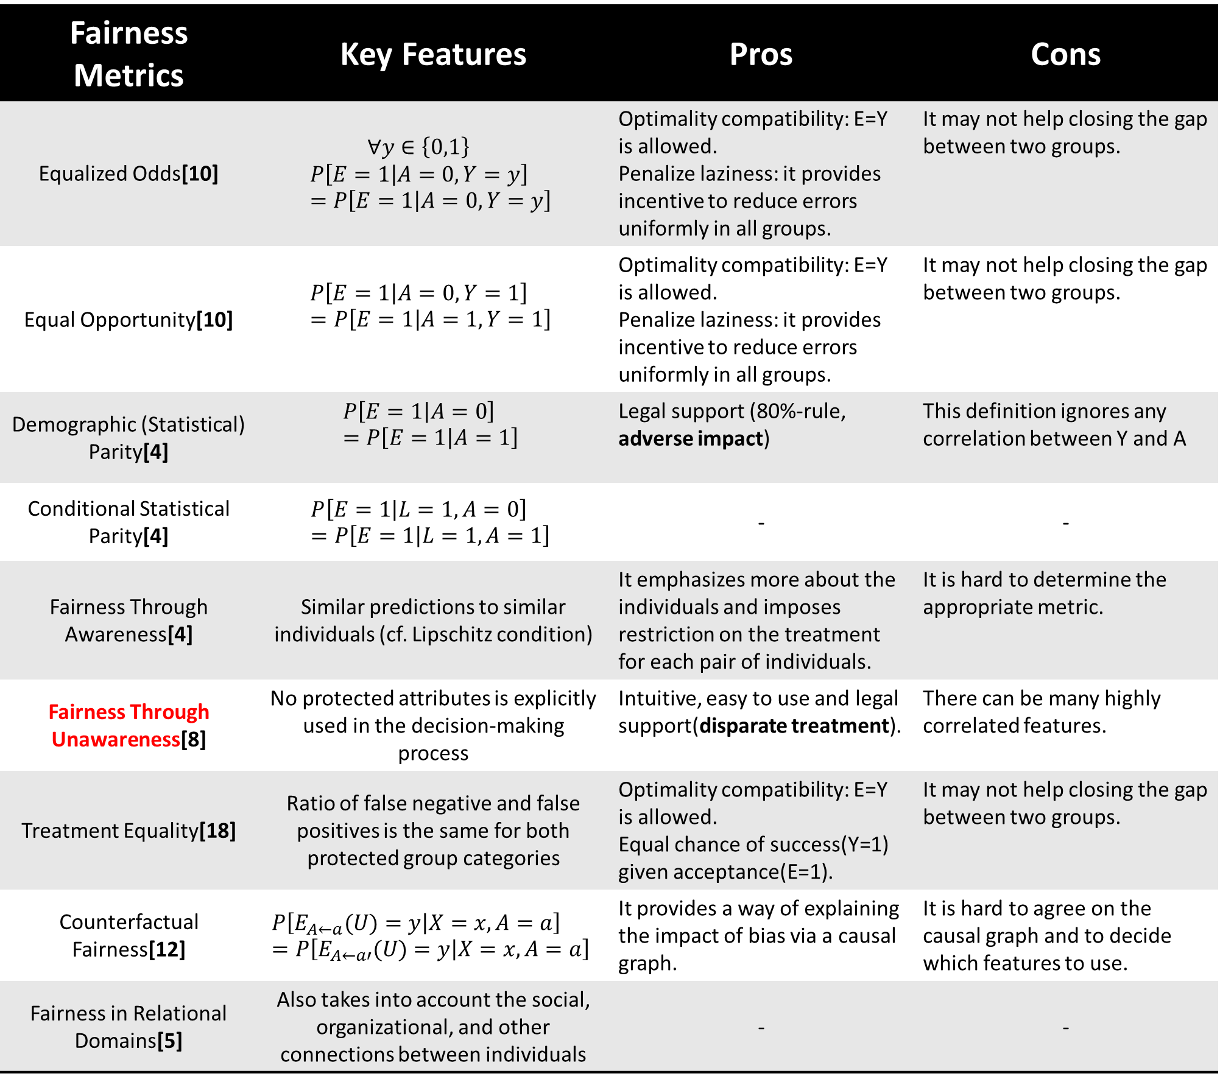
Fairness Metrics | Key Features | Pros | Cons
Equalized Odds[10] | $$∀y∈\left\{0,1\right\}$$ $$P\left[E=1 | A=0, Y=y\right]=P\left[E=1 | A=0, Y=y\right]$$ | Optimality compatibility: E=Y is allowed. Penalize laziness: it provides incentive to reduce errors uniformly in all groups. | It may not help closing the gap between two groups.
Equal Opportunity[10] | $$P\left[E=1 | A=0, Y=1\right]=P\left[E=1 | A=1, Y=1\right]$$ | Optimality compatibility: E=Y is allowed. Penalize laziness: it provides incentive to reduce errors uniformly in all groups. | It may not help closing the gap between two groups.
Demographic (Statistical) Parity[4] | $$P\left[E=1 | A=0\right]=P\left[E=1 | A=1\right]$$ | Legal support (80%-rule, adverse impact) | This definition ignores any correlation between Y and A
Conditional Statistical Parity[4] | $$P\left[E=1 | L=1, A=0\right]=P\left[E=1 | L=1, A=1\right]$$ | - | -
Fairness Through Awareness[4] | Similar predictions to similar individuals (cf. Lipschitz condition) | It emphasizes more about the individuals and imposes restriction on the treatment for each pair of individuals. | It is hard to determine the appropriate metric.
Fairness Through Unawareness[8] | No protected attributes is explicitly used in the decision-making process | Intuitive, easy to use and legal support(disparate treatment). | There can be many highly correlated features.
Treatment Equality[18] | Ratio of false negative and false positives is the same for both protected group categories | Optimality compatibility: E=Y is allowed. Equal chance of success(Y=1) given acceptance(E=1). | It may not help closing the gap between two groups.
Counterfactual Fairness[12] | $$P\left[E_{A←a}(U)=y | X=x, A=a\right]=P\left[E_{A←a′}(U)=y | X=x, A=a\right]$$ | It provides a way of explaining the impact of bias via a causal graph. | It is hard to agree on the causal graph and to decide which features to use.
Fairness in Relational Domains[5] | Also takes into account the social, organizational, and other connections between individuals | - | -

